Slide 1
CareAir: Explainable Reasoning for Healthcare Ventilation Compliance
Team HVCC : Ahosan Habib · Nipun Deelaka · Andy Cheng · Carina Liu
Ontology Engineering 2026 (CSCI 6340) · Assignment 5 · Use Case Presentation

Slide 2
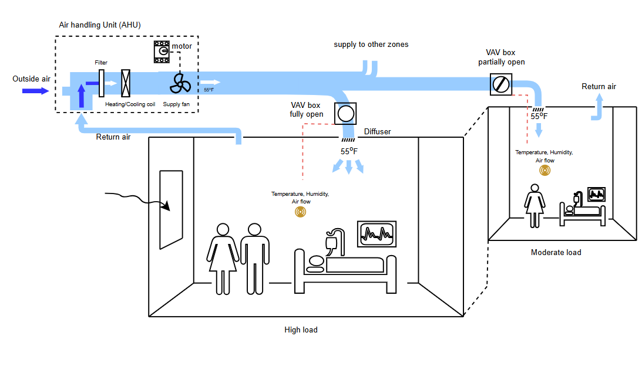
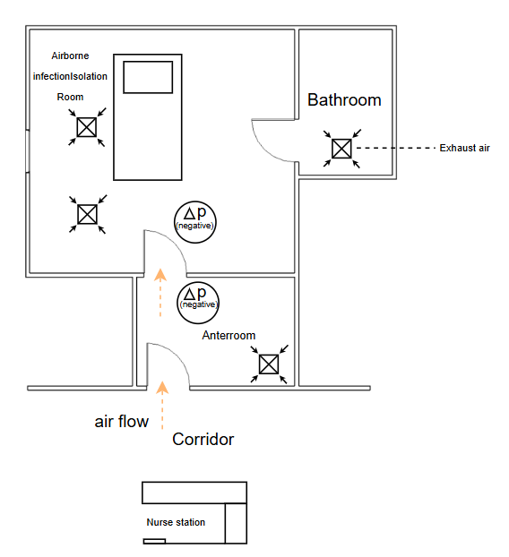
An Instance of a Hospital Scenario
Air Imbalance = Supply − Return − Exhaust
Pressure sense = ± (Air Imbalance)

Slide 3
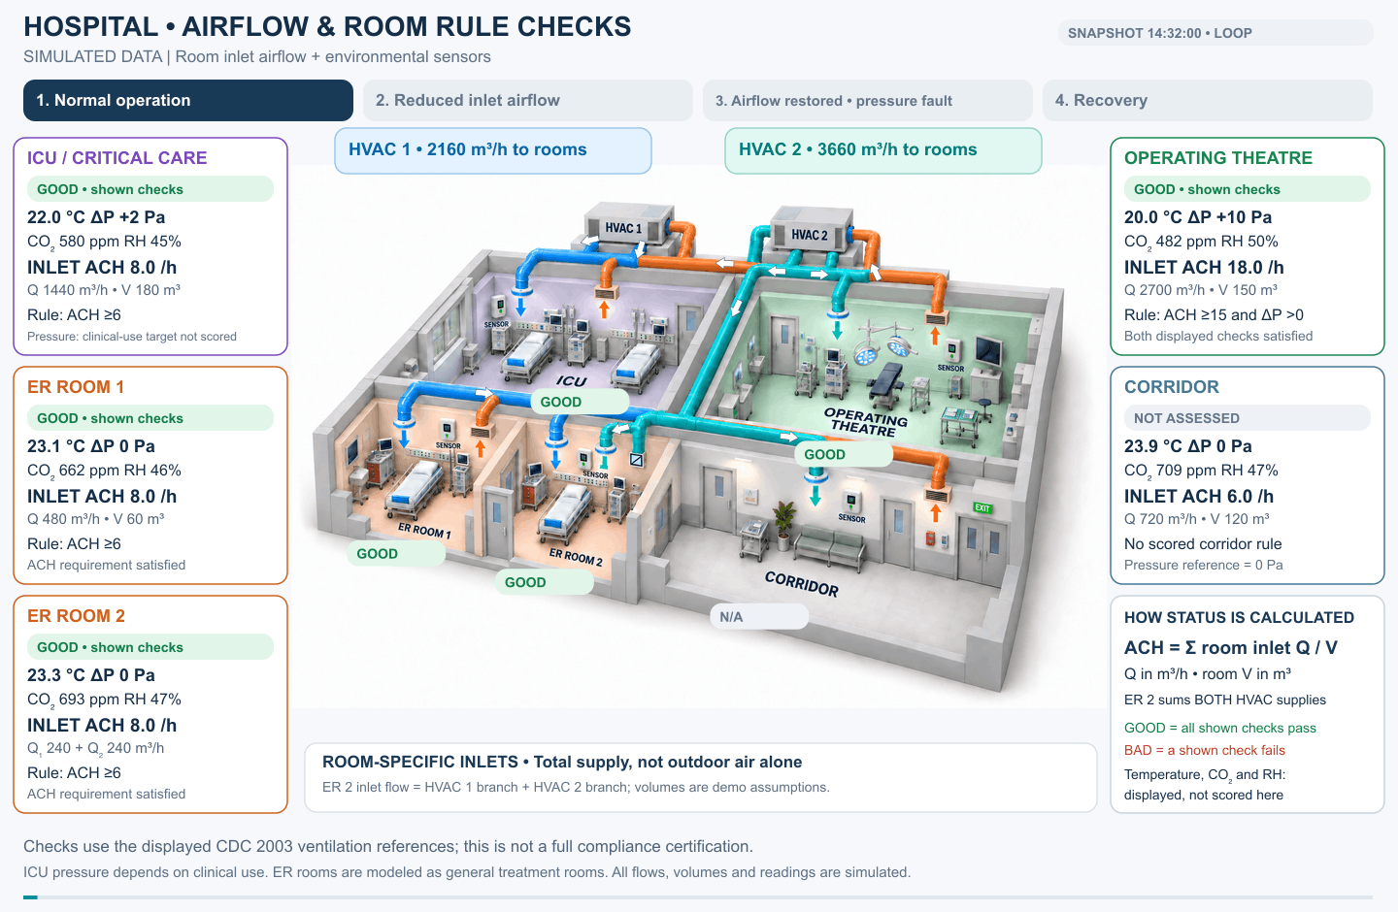
Usage Scenario

Slide 4
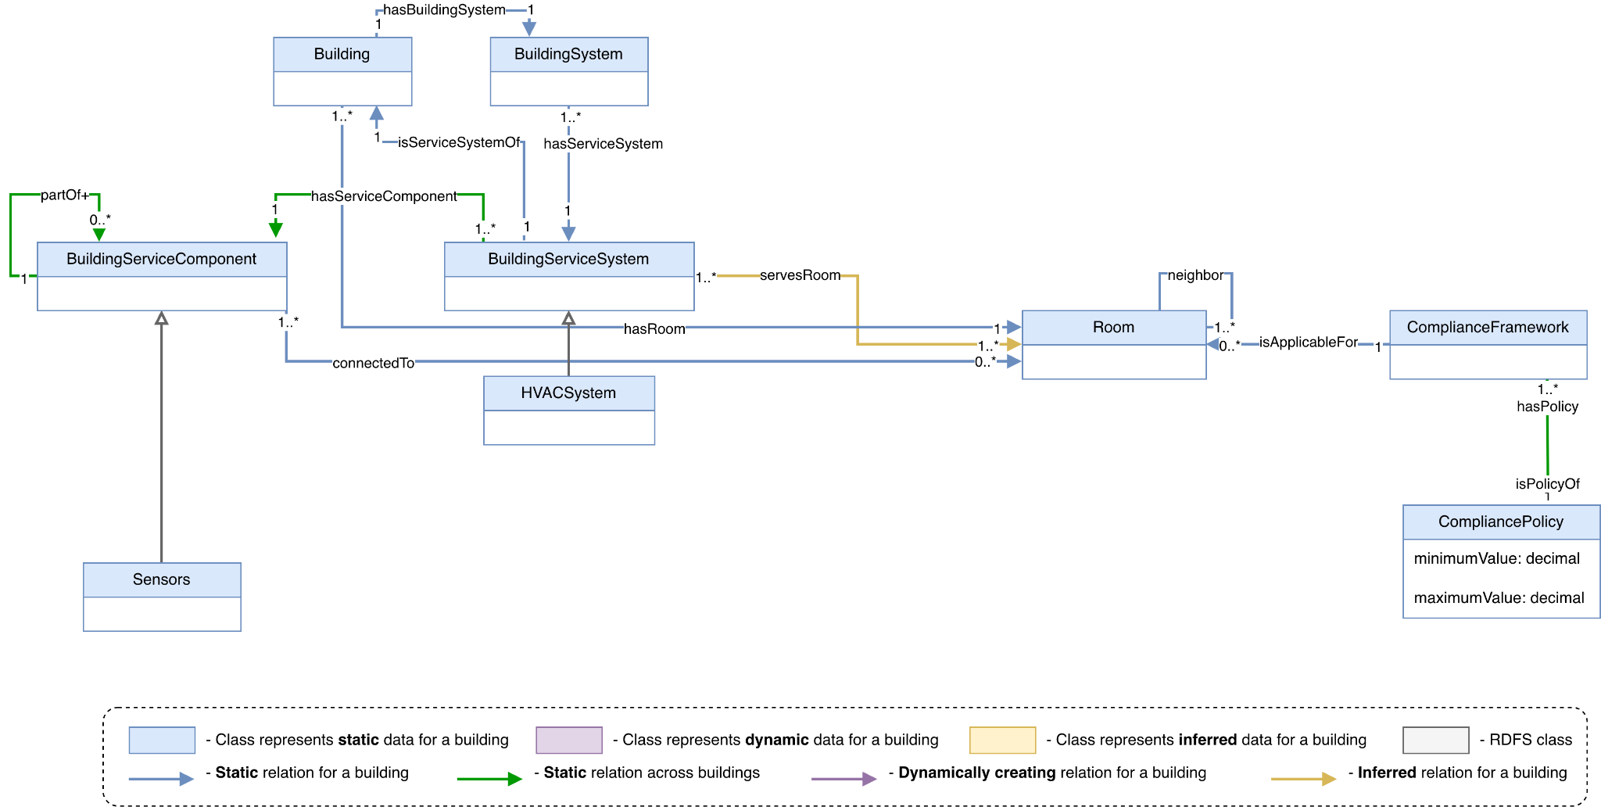
Conceptual Model

Slide 5
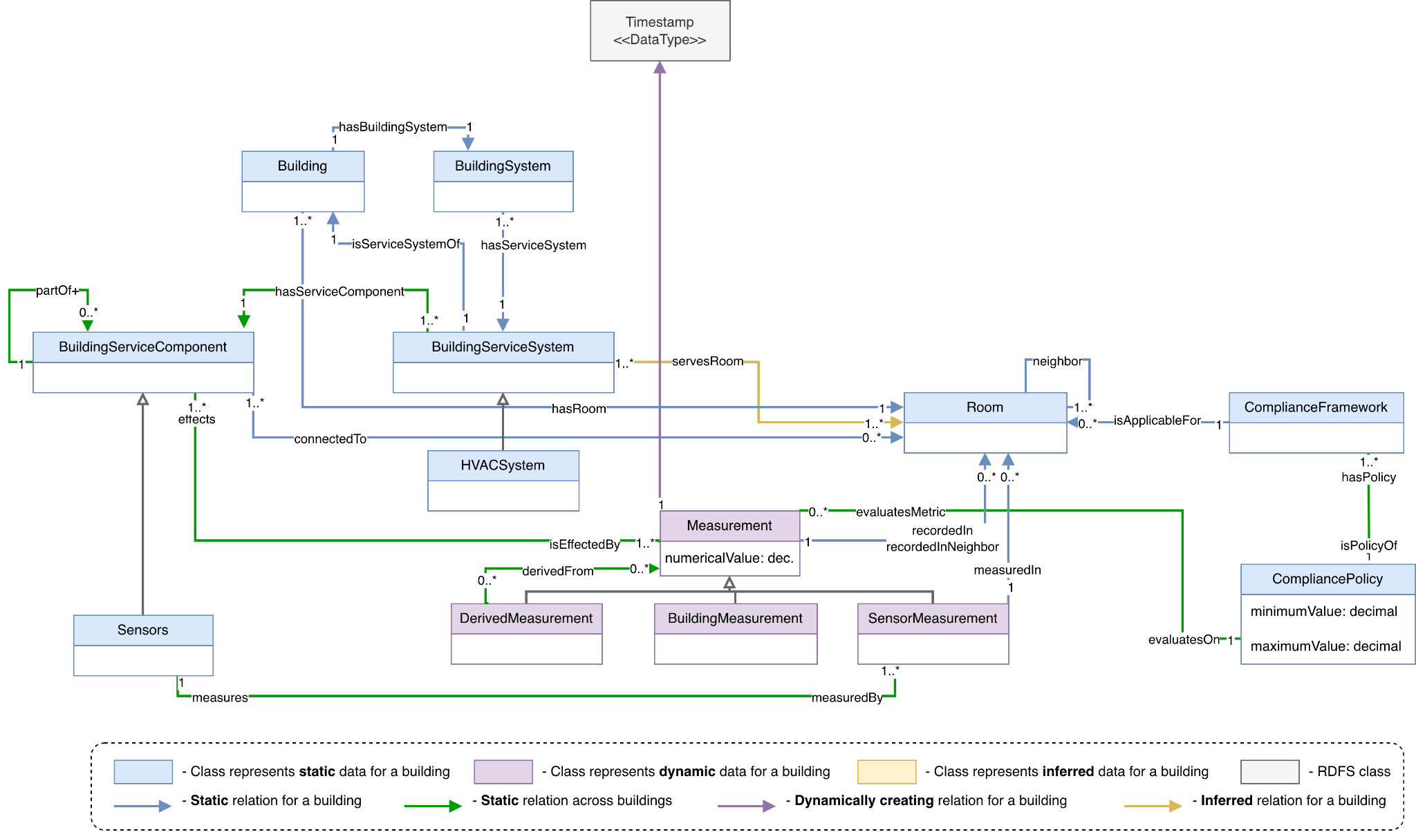
Conceptual Model

Slide 6
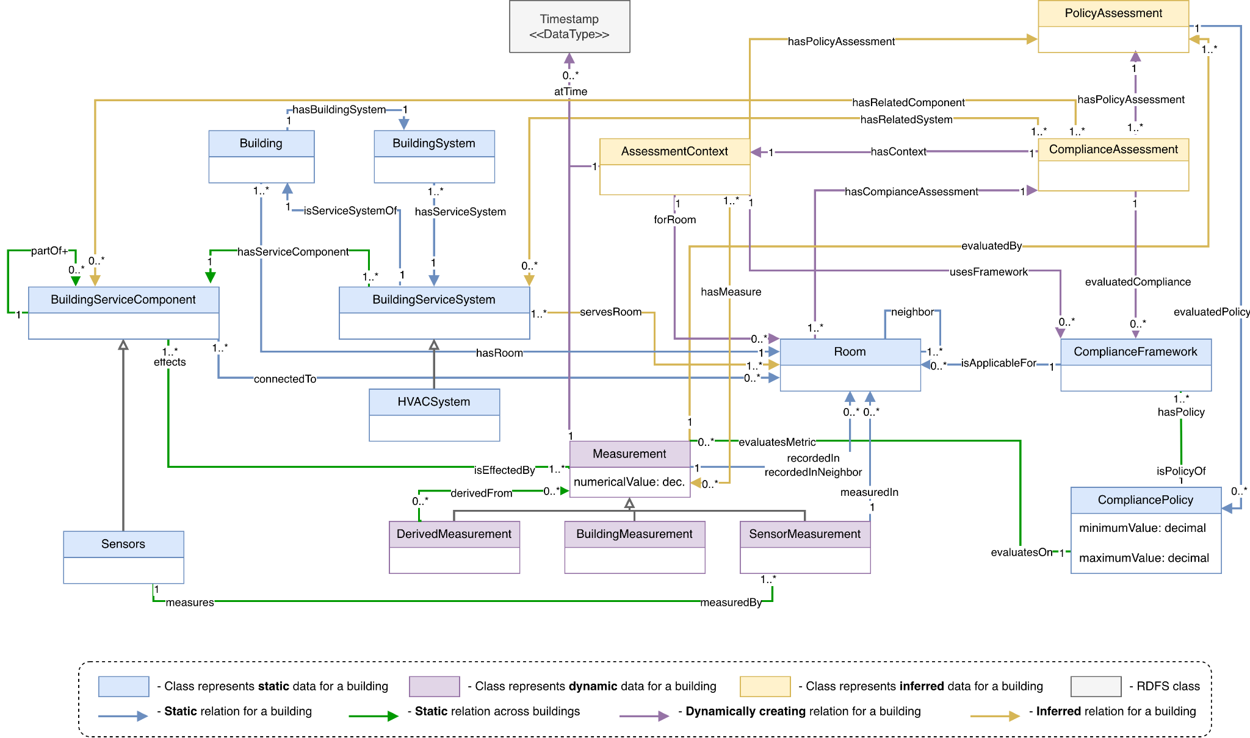
Conceptual Model

Slide 7
Competency Question 1: Which airborne infection isolation rooms are currently failing their required negative pressure differential?
Context
1 Requirement
The system sees that Room 4E-12 is an Isolation Room, so it automatically pulls the strict policy that says it must be at -2.5 Pascals.
Imagine an infection preventionist needs to immediately place a highly contagious patient, but they cannot trust an outdated spreadsheet. They need live data.
2 Live Data
It queries the physical sensors in that exact room to see what the pressure is right now—let's say it's -0.8 Pascals.
3 Comparison
The system acts as an automated bridge, comparing the live reading (-0.8) against the requirement (-2.5). Because it falls short, it immediately flags the room as non-compliant.
System Answer - Room 4E-12 is NON-COMPLIANT. (Reading: -0.8 Pa | Required: -2.5 Pa)

Slide 8
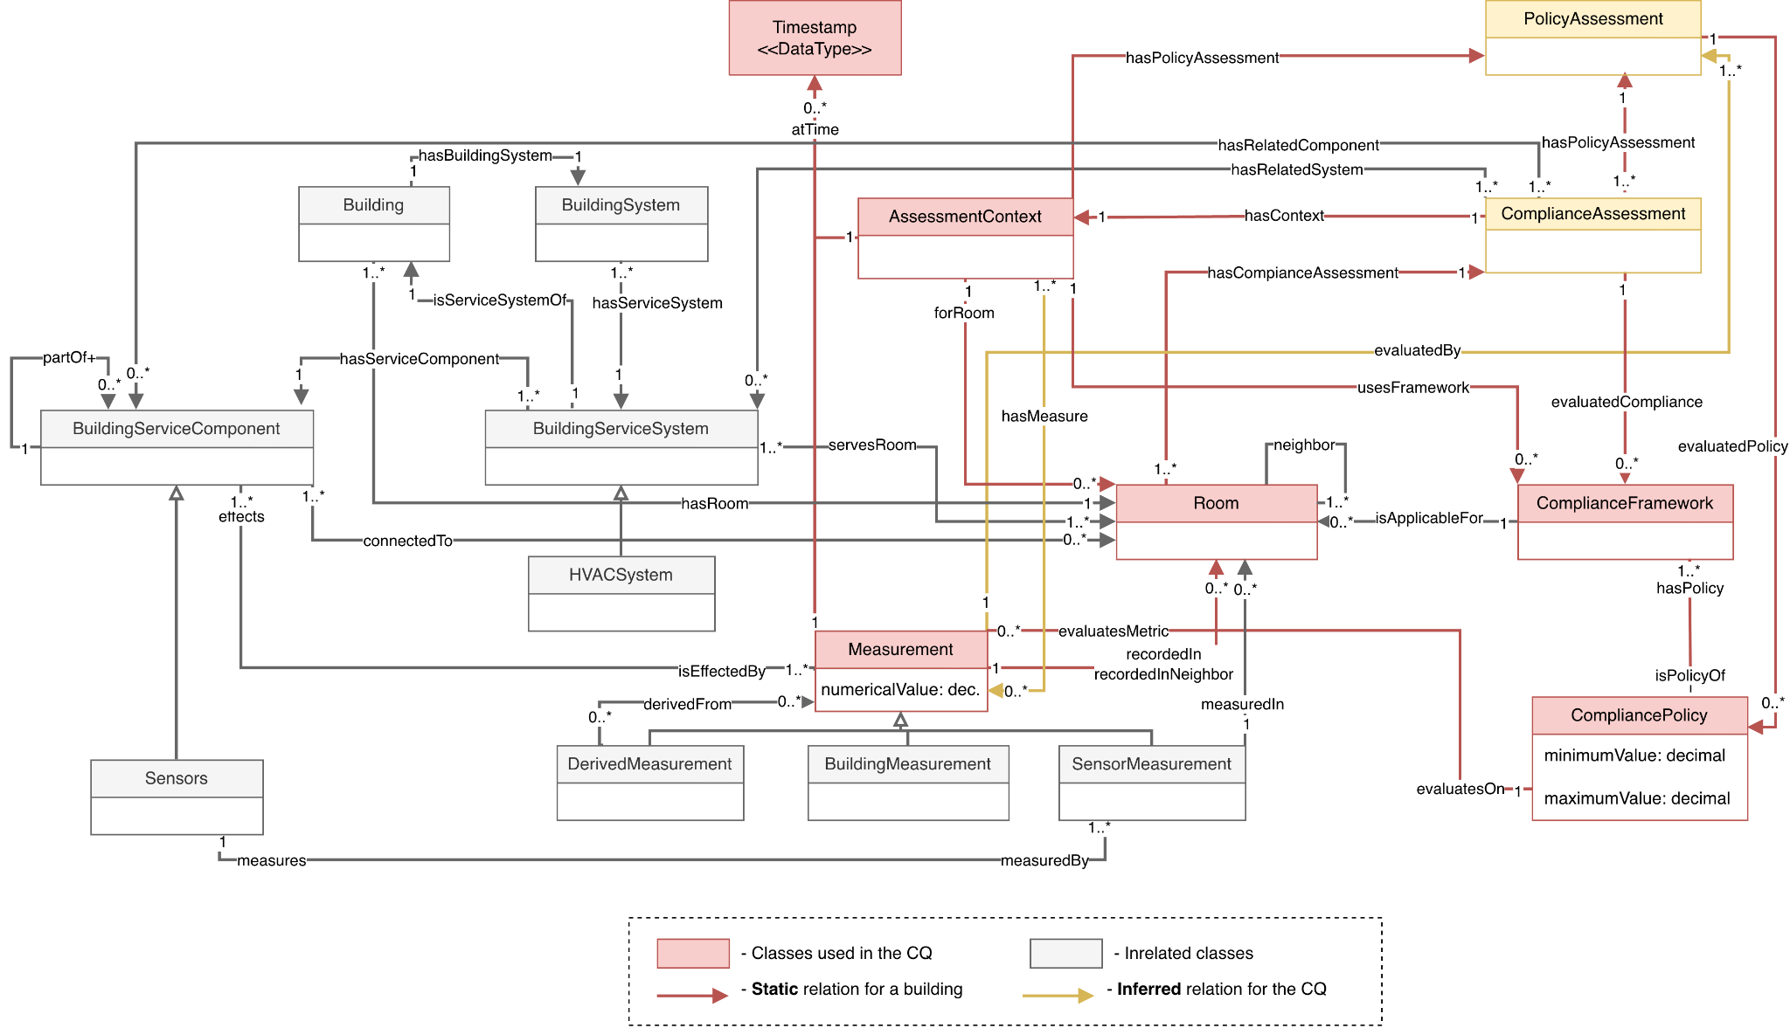

Slide 9
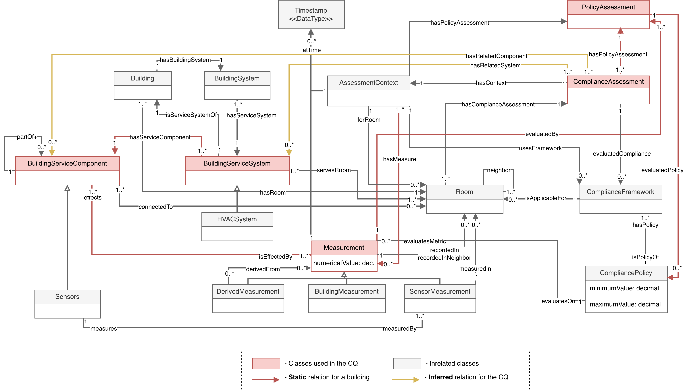

Slide 10
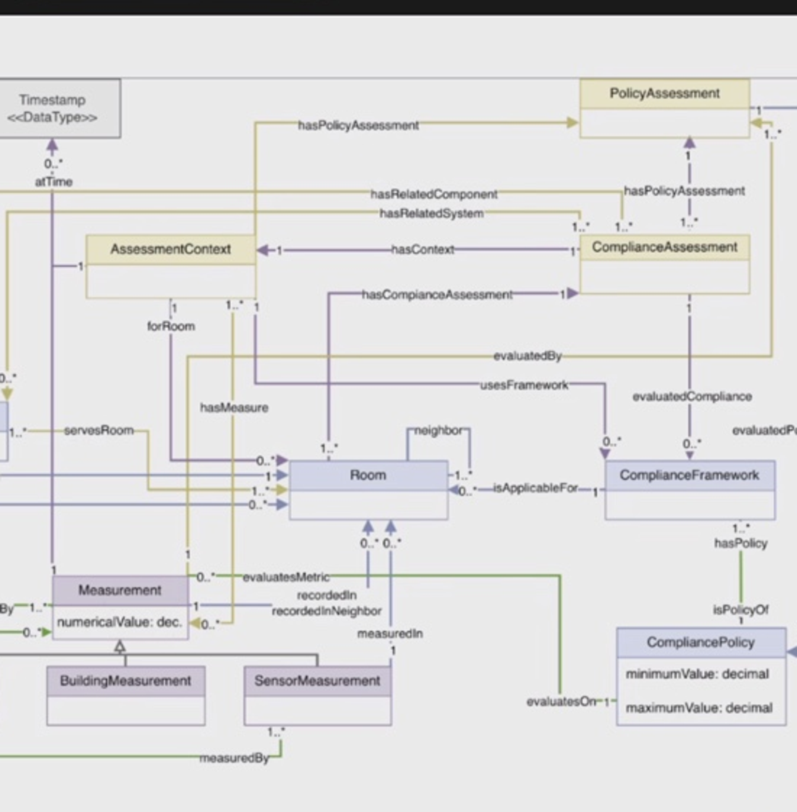
Red Part: HVAC Compliance Assessment Flow
How my classes connect the physical HVAC system, measurements, and compliance policies.
Building system
→
Measurements
→
Context
→
Assessment
Core story: actual building data is compared with required policy thresholds.
HVCC Conceptual Model · Red Part · 1
Notes:
For my part, I will focus on the classes highlighted in red and explain how they connect the physical HVAC system to the compliance assessment process. The main story is: we start from a building service system and its components, collect measurements, put those measurements into an assessment context, and then compare the actual measurement values with the requirements in the compliance policies.

Slide 11
1) Physical layer: system and components
These classes describe where the data comes from in the building.
BuildingServiceSystem
(e.g., HVAC system)
BuildingServiceComponent
(e.g., VAV box, fan, duct)
Measurement
(actual building data)
→
→
Key relationship
Example
A system has service components. Components affect the measurements we use later.
HVAC System A → VAV Box 1 → influences airflow / ACH measurement.
HVCC Conceptual Model · Red Part · 2
Notes:
First, we have BuildingServiceSystem and BuildingServiceComponent. A BuildingServiceSystem represents a service system in the building, such as an HVAC system. A BuildingServiceComponent represents the individual components that belong to that system, such as a fan, duct, or VAV box. These components can affect conditions in the building, so they can influence the measurements that we collect. For example, a VAV box can affect the airflow going into a room, and that airflow can later be used to calculate air changes per hour.

Slide 12
2) Data layer: Measurement is the actual value
Measurement stores the real numeric evidence used for compliance evaluation.
Measurement
AssessmentContext
Room + time + relevant data
→
→
numericalValue: decimal
Actual data
Context means:
ACH = 8
Temperature = 22°C
Humidity = 48%
“What room are we evaluating, and what data are we using?”
HVCC Conceptual Model · Red Part · 3
Notes:
This leads to the Measurement class. Measurement represents the actual numerical data used in the model, such as airflow, temperature, humidity, or air changes per hour. It contains a numerical value and can be associated with a room and a time. Then the measurement connects to AssessmentContext through the hasMeasure relationship. I think of AssessmentContext as the input or background information for an assessment. It tells us which room we are evaluating and which measurements are relevant for that room.

Slide 13
3) Assessment layer: from context to policy checks
The context becomes an overall assessment, then detailed checks for each policy.
AssessmentContext
input/background
ComplianceAssessment
overall evaluation
PolicyAssessment
one policy check
CompliancePolicy
required threshold
→
→
→
ComplianceAssessment
PolicyAssessment
Checks whether a room or system satisfies the standards overall.
One specific check, such as ACH, humidity, or temperature.
HVCC Conceptual Model · Red Part · 4
Notes:
Next, ComplianceAssessment uses the context. ComplianceAssessment represents the overall evaluation of whether the room or building system satisfies the required standards. One ComplianceAssessment can contain multiple PolicyAssessments, because one room may need to check several requirements, such as airflow, humidity, and temperature. Each PolicyAssessment evaluates one specific CompliancePolicy. The CompliancePolicy defines the actual requirement, including minimum and maximum values.

Slide 14
Example: actual value vs required value
This is the easiest way to explain the whole red part.
Measurement
actual ACH = 8
compared with
CompliancePolicy
minimum ACH = 12
PolicyAssessment
8 < 12 → Non-compliant
→
Final takeaway
My red part connects the physical HVAC system, measured building data, and compliance rules so the ontology can support automated compliance assessment.
HVCC Conceptual Model · Red Part · 5
Notes:
For example, suppose a room has an actual ACH measurement of 8, while the compliance policy requires a minimum ACH of 12. The measurement gives us the actual value. The policy gives us the required value. The PolicyAssessment compares them. Since 8 is below 12, the system can determine that this specific requirement is not satisfied. So overall, my part connects the physical HVAC system, the measured building data, and the compliance rules, allowing the ontology to support an automated compliance assessment.

Slide 15
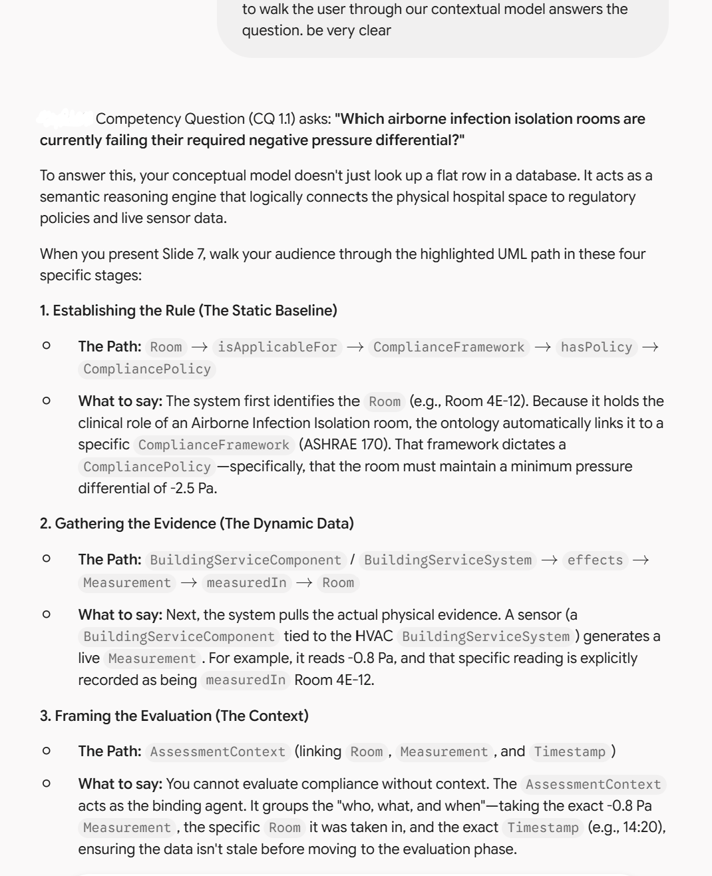
GenAI Use
Model: Gemini
Utilized Gemini to structure the explanation of my conceptual diagram. The model helped me break down the technical pathways so I could clearly demonstrate to the audience how the diagram answers our competency question.

